Slide 1
Improving ResNet-based Feature Extractor for Face Recognition via Re-ranking and Approximate Nearest Neighbor Search
Presenter: Sheng-Hsing Hsiao
Advisor: Jyh-Shing Roger Jang
Dept. of CSIE, National Taiwan University, Taiwan

Slide 2
Outline
Introduction
Related Work
Methods
Experiments
Conclusions
References

Slide 3
Introduction
Face Recognition System
Barack Obama
Ma Ying-jeou
Compare two different face detectors on three benchmarks
Evaluate the performance of face verification
Present the suitable configuration on different datasets

Slide 4
Related Work

Slide 5
Related Work

Slide 6
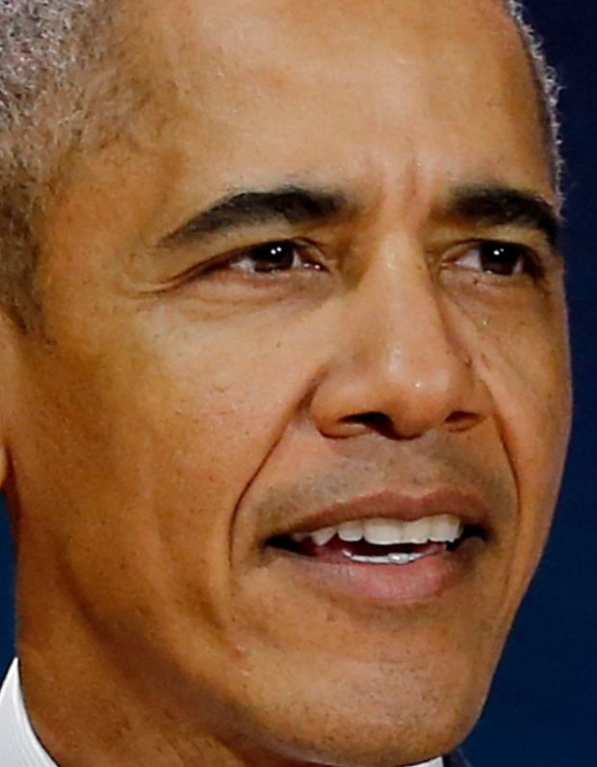
Method
System flowchart
Input image
Face
Detection
Face verification
Face
identification
Measure similarity
Face
Alignment
Face Feature Extractor
Re-ranking
Aligned face
Face representations
Below the
threshold
Barack Obama
Intruder
Notes:
合成一張

Slide 7
Method of Face Detection (1/2)
Face detection
Faceboxes: A CPU real-time face detector with high accuracy
https://arxiv.org/pdf/1708.05234
Notes:
Rapidly Digested Convolutional Layers 主要是解決速度問題
快速的縮小feature map的大小
採用C.ReLU activation function
使用CRelU來保證輸出維度不變的情況下，減少卷積核數量
Multiple Scale Convolutional Layers(MSCL)
類似於SSD，在網絡的不同層進行檢測
作者提出來的點就在於增加小的anchor的訓練
定義了anchor 密度 來平衡對密度不足的anchor來增加偏移訓練

Slide 8
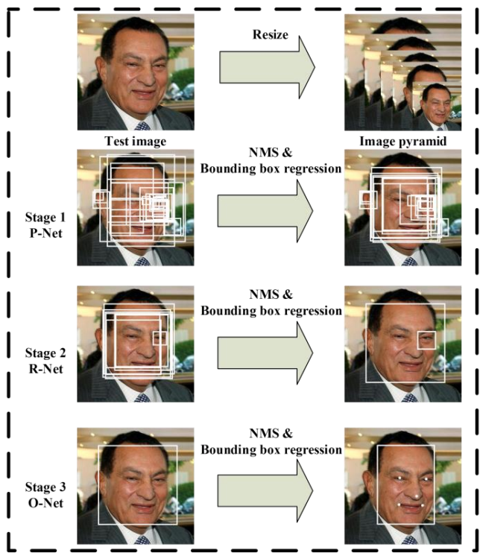
Method of Face Detection (2/2)
Face detection
MTCNN: Joint Face Detection and Alignment using Multi-task Cascaded Convolutional Networks
https://arxiv.org/abs/1604.02878
Notes:
在2016年提出的一個multi-task 論文的人臉偵測還有人臉特徵同時進行
給定一張照片的時候，將其縮放到不同尺度形成圖像金字塔，以達到尺度不變
總共有三個CNN cascade
3個stage對人臉的處理是按照一種由粗到細的方式
pnet是一個全卷積網絡(FCN)，全卷積網絡的優點在於可以輸入任意尺寸的圖像，生成人臉分類、一些bounding box、還有人臉上的landmark
使用Bounding box regression的方法來校正這些候選窗
使用非極大值抑制（NMS）合併重疊的候選框

Slide 9
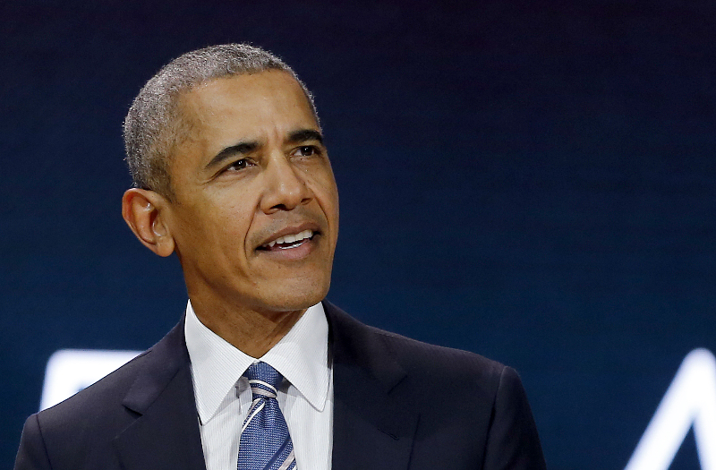


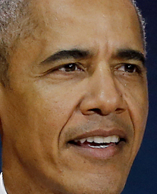
Method of Face Alignment
Dlib
V Kazemi, “One millisecond face alignment with an ensemble of regression trees.”
2D alignment to get the canonical view of a face

Slide 10
Method of Face Feature Extractor
VGGFace2 (2018)
Dataset: VGGFace2 dataset
9131 celebrities, 8631 for training, 500 for test
3.31 million + faces, average 362 samples per-subject
Backbone: ResNet-50 (2016)
Convert the problem to N-ways classification problem and train on MS-Celeb-1M dataset
Remove the FC layer and get vectors, and then fine-tune on VGGFace2 as an 8631-classes classifier
Notes:
Parkhi, Omkar M., Andrea Vedaldi, and Andrew Zisserman. "Deep face recognition." bmvc. Vol. 1. No. 3. 2015.
先視為一個8631類的分類氣，
接著再把最後一層拿掉，變成face vector
還可以用triplet loss 來fine-tune 为什么不适用 softmax函数呢，softmax最终的类别数是确定的，而Triplet loss学到的是一个好的embedding，相似的图像在embedding空间里是相近的，可以判断是否是同一个人脸。

Slide 11
Method of Approximate Nearest Neighbor
Curse of Dimensionality
KNN do not generalize well in high dimension
ANN (Approximate Nearest Neighbor)
HNSW (Hierarchical Navigable Small World)
graph-based, without any need for additional search structures
https://arxiv.org/pdf/1603.09320
Notes:
Knn在高為的表現不好，因為有維度災難
在樣本數一樣的情況下，為度越高在空間的分佈越稀疏
越接近這個球的中心就越稀疏，當維度一直增加距離趨近於1
因為knn完全對data不做處理，如果樣本不夠多很容易overfitting
KNN就是要比n次, ann可以想像成對空間的劃分，可以找到子空間，不用所有的空間都找過，速度快但是犧牲一些準確
ＨＮＳＷ是一個greedy，先用粗略地找（邊比較大）達到局部最小的時候，再往下一層找，這層的邊都會比較小， 可以有效降低複雜度
https://www.zhihu.com/question/27836140 http://www.visiondummy.com/2014/04/curse-dimensionality-affect-classification/
self study - Curse of dimensionality: kNN classifier - Cross Validated
https://www.ryanligod.com/2018/11/27/2018-11-27%20HNSW%20%E4%BB%8B%E7%BB%8D/ https://stats.stackexchange.com/.../curse-of-dimensionality-knn-classifier

Slide 12
Method of Re-ranking
Re-ranking policies (naive)
Probe Image
(#099)
#217_3
0.712273
#099_1
0.710558
#099_4
0.694191
#184_3
0.692250
#099_0
0.691296
#099_1
0.719207
#099_4
0.708678
#312_3
0.701612
#217_3
0.695524
#184_3
0.685185
Flipped Probe Image
#099: 0.704786
#217: 0.703898
#312: 0.701612
#184: 0.688717
After re-ranking
Notes:
409_0, 312_3, 280_2, 012_3, 409_2

Slide 13
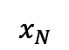
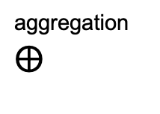
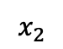
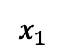
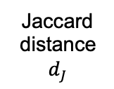
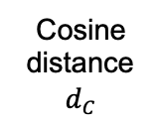
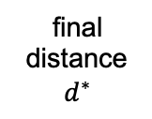
Method of Re-ranking
Re-ranking policy (our proposed)
Sample
Feature
Extraction
Distance Measurement
Aggregation
Gallery
Probe
Cosine
distance
$d_{C}$
aggregation
$$⨁$$
…
Jaccard
distance
$d_{J}$
$$x_{1}$$
$$x_{2}$$
$$x_{N}$$
final
distance
$d^{∗}$
Notes:
409_0, 312_3, 280_2, 012_3, 409_2

Slide 14
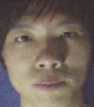
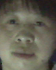
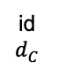
Method of Re-ranking
Re-ranking policy (our proposed)
id
$$d_{C}$$
#343_4
0.206344
#310_1
0.264809
#152_4
0.265400
#379_3
0.284193
#257_3
0.289902
Probe Image
(#379)
Notes:
409_0, 312_3, 280_2, 012_3, 409_2

Slide 15
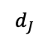
Method of Re-ranking
Re-ranking policy (our proposed)
id
$$d_{C}$$
#343_4
0.206344
#310_1
0.264809
#152_4
0.265400
#379_3
0.284193
#257_3
0.289902
Probe Image
(#379)
$$d_{J}$$
0.8
0.8
1
0.8
1
Notes:
409_0, 312_3, 280_2, 012_3, 409_2

Slide 16
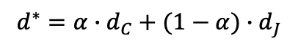
Method of Re-ranking
Re-ranking policy (our proposed)
id
$$d_{C}$$
#343_4
0.206344
#310_1
0.264809
#152_4
0.265400
#379_3
0.284193
#257_3
0.289902
Probe Image
(#379)
$$d^{∗}=α∙d_{C}+(1−α)∙d_{J}$$
$$d_{J}$$
0.8
0.8
1
0.8
1
Notes:
409_0, 312_3, 280_2, 012_3, 409_2

Slide 17
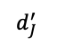
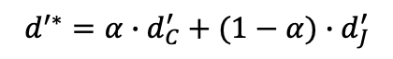
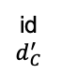
Method of Re-ranking
Re-ranking policy (our proposed)
id
$$d_{C}^{′}$$
#379_2
0.267590
#152_4
0.267723
#379_3
0.276431
#310_1
0.279959
#379_1
0.282797
Flipped Probe Image
(#379)
$$d^{′∗}=α∙d_{C}^{′}+(1−α)∙d_{J}^{′}$$
$$d_{J}^{′}$$
0.4
1
0.4
0.8
0.6
Notes:
409_0, 312_3, 280_2, 012_3, 409_2

Slide 18
Experiments
Experimental settings
OS: Ubuntu 16.04
CPU: Intel(R) Xeon(R) E5-2630 10 cores @ 2.20GHz
GPU: GeForce GTX 1080 Ti
Memory: 128GB
Code language: Python 3.6.7

Slide 19
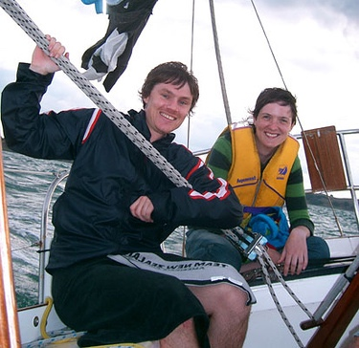
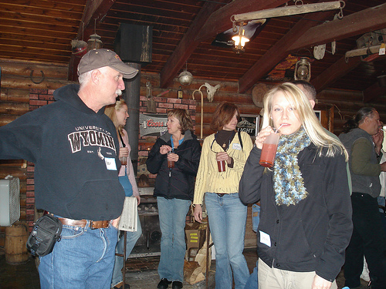
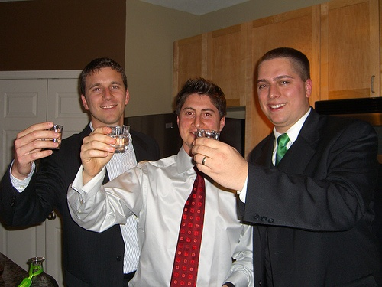
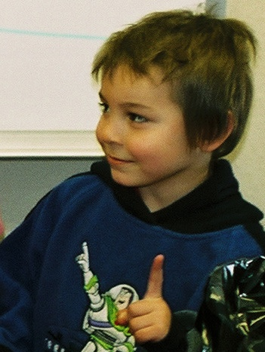
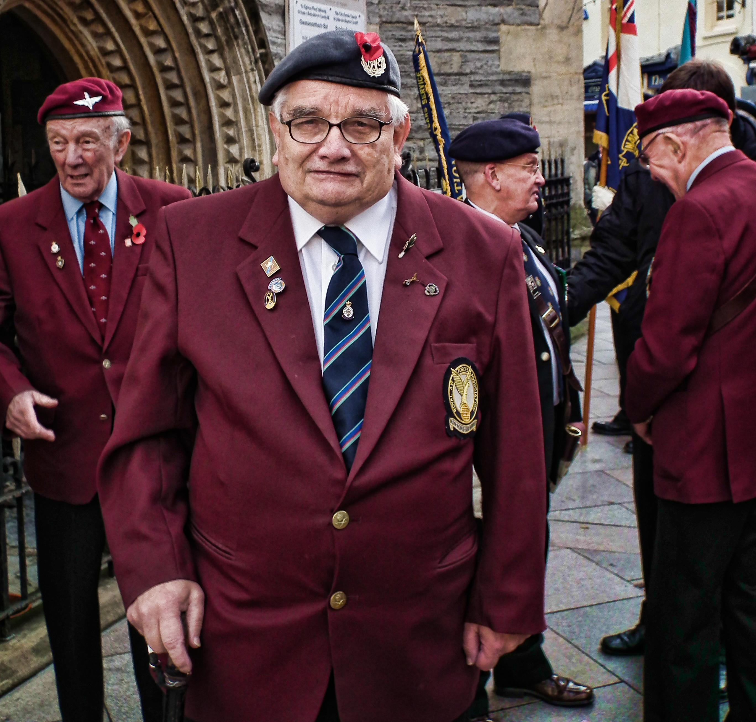
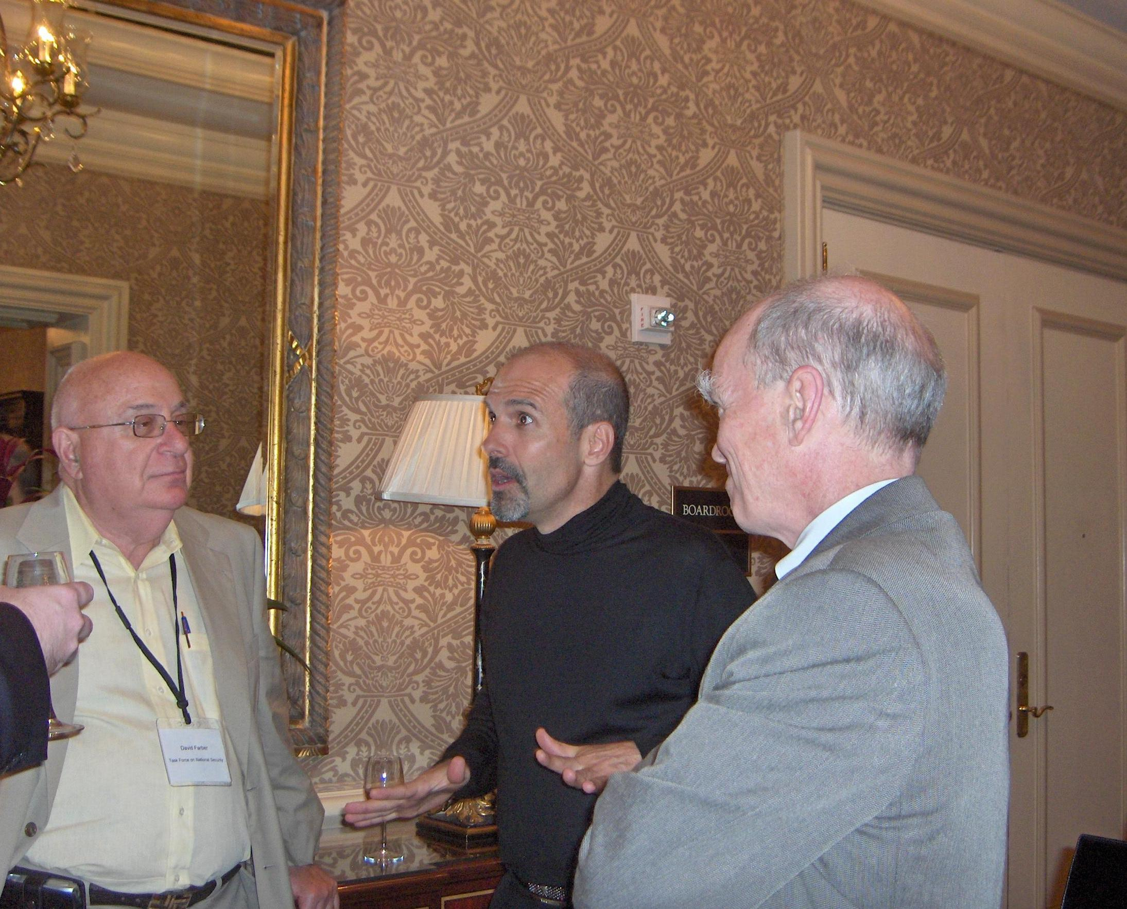
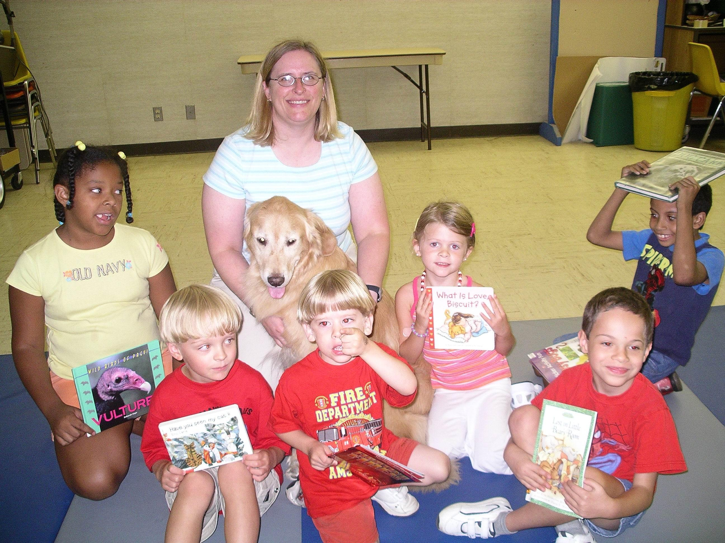
Experiments of Face Detection
Performance of face detection
Datasets
PASCAL face
1335 faces from 851 images
Some examples:
AFW
205 images with 473 labeled faces
Some examples:
Notes:
PASCAL person layout dataset
Annotated Faces in the Wild

Slide 20
Experiments of Face Detection (cont.)
Performance of face detection
Datasets
FDDB
5,171 faces in 2,845 images
Evaluate on discrete ROC curves
Provide bounding ellipse
Data-preprocessing: convert the ellipses to minimum bounding rectangles
bounding ellipse
Notes:
Face Detection Data Set and Benchmark
離散的意思是一個face一個face看

Slide 21
Experiments of Face Detection (cont.)
Evaluation of face detection runtime
Dataset
UTKFace
Large-scale face dataset and only single face in one image
23,709 facial images
https://susanqq.github.io/UTKFace/

Slide 22
Experiments of Face Detection (cont.)
Performance of face detection
Intersection over Union (IOU)
An Intersection over Union score > 0.5 is normally considered a “good” prediction. Depending on the metric, threshold usually be set to 50%, 75% or 95%.
True Positive (TP): A correct detection. Detection with IOU ≥ threshold
False Positive (FP): A wrong detection. Detection with IOU < threshold
False Negative (FN): A ground truth not detected
True Negative (TN): Does not apply.

Slide 23
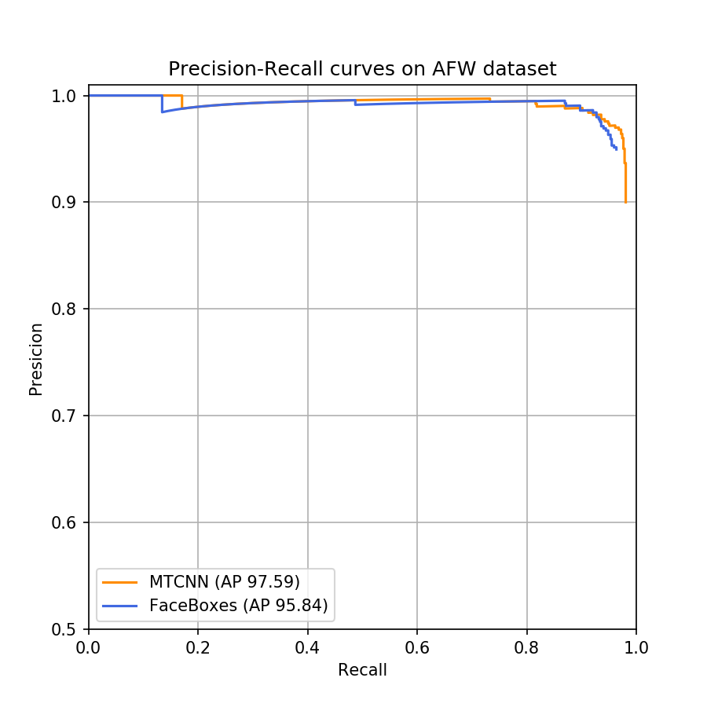
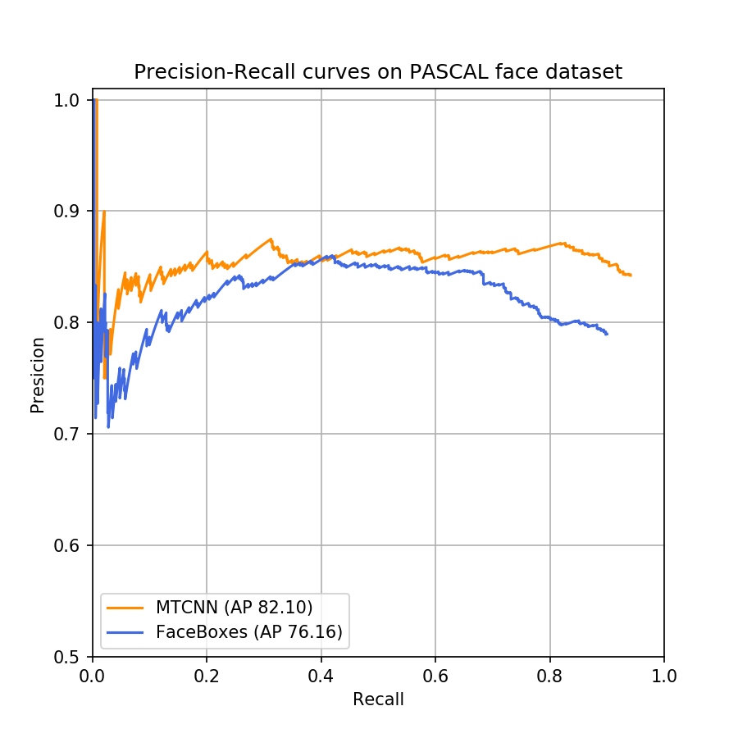
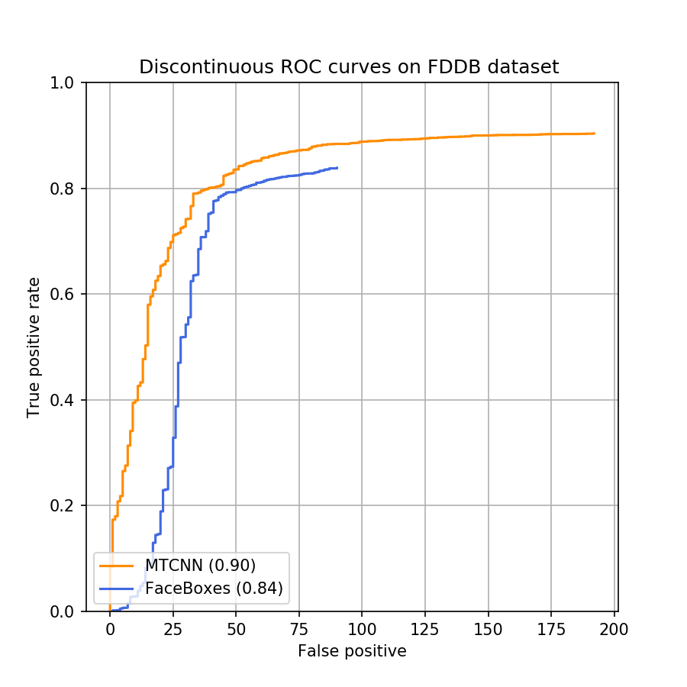
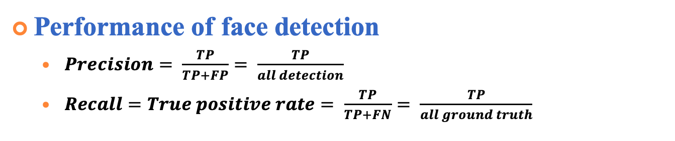
Experiments of Face Detection (cont.)
Performance of face detection
$Precision= \frac{TP}{TP+FP}= \frac{TP}{all detection}$
$Recall=True positive rate= \frac{TP}{TP+FN}= \frac{TP}{all ground truth}$
AFW dataset
PASCAL face dataset
FDDB dataset
Notes:
Average precision 就是曲線下的面積
ＦＤＤＢ他有自己的評估方式類似roc的方式，橫軸是false positive

Slide 24
Experiments of Face Detection (cont.)
Evaluation of face detection runtime
Dataset
UTKFace
Approach | mAP(%) | FPS (On GPU) | FPS (On CPU)
MTCNN | 94.4% | 8.86 | 6.25
FaceBoxes | 89.3% | 42.91 | 20.07

Slide 25
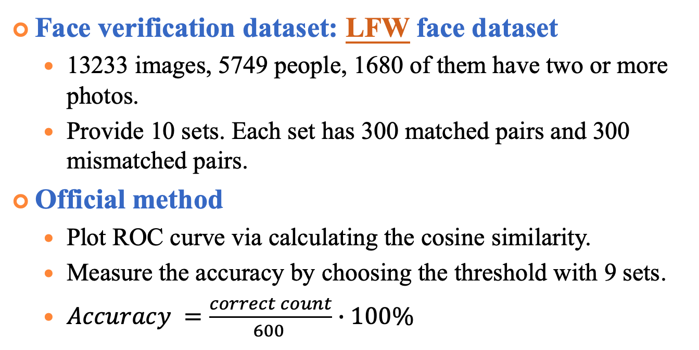
Experiments of Face Verification
Face verification dataset: LFW face dataset
13233 images, 5749 people, 1680 of them have two or more photos.
Provide 10 sets. Each set has 300 matched pairs and 300 mismatched pairs.
Official method
Plot ROC curve via calculating the cosine similarity.
Measure the accuracy by choosing the threshold with 9 sets.
$Accuracy =\frac{correct count}{600 }∙100\%$
Match pairs
Mismatch pairs
http://vis-www.cs.umass.edu/lfw/
Notes:
Labeled Faces in the Wild ver/rec
http://vis-www.cs.umass.edu/lfw/index.html

Slide 26
Experiments of Face Verification (cont.)
Performance evaluation on LFW
 | Accuracy (%) | Time (s)
VGG16 | 95.33% | 129
Resnet50 | 99.33% | 139
Notes:
有 9 fold 每個fold都有自己的fpr/tpr 曲平均可以畫出平均的roc curve
10 個Auc的標準差代表一個標準差是0.001
標準差 根據fold/acc
設定一段threshold的區間，透過10fold算各自錯幾個，選擇平均錯最少的當作threshold 接著再用此threshold當作標準算10fold各自的accuracy平均 小標題要寫ver/rec

Slide 27
Experiments of Face Verification (cont.)
Authorized user dataset
CASIA-FaceV5
2,500 color facial images of 500 subject, each has 5 images
For each user, 4 images for gallery images and 1 image for test.
All face images are 16 bit color BMP files and the image resolution is 640*480
http://biometrics.idealtest.org/dbDetailForUser.do?id=9
Notes:
http://biometrics.idealtest.org/dbDetailForUser.do?id=9

Slide 28
Experiments of Face Verification (cont.)
Intruder dataset
Helen dataset
2000 images as the intruder dataset
If there are multiple faces in the picture, select the one closest the image center as the test face.
http://www.ifp.illinois.edu/~vuongle2/helen/

Slide 29
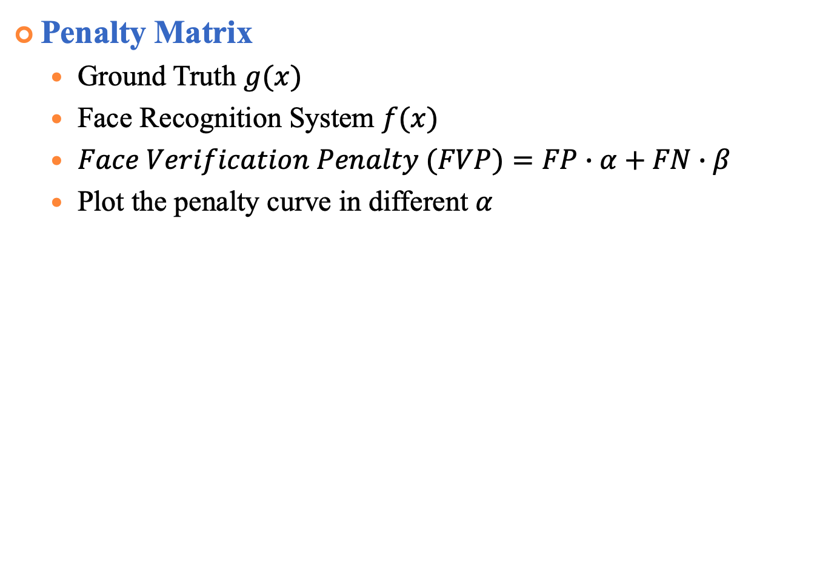
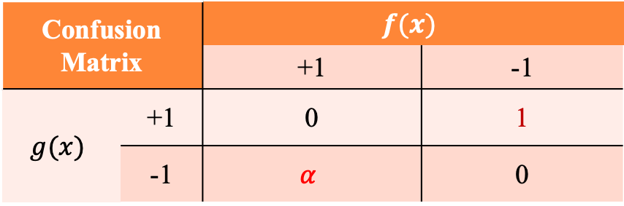
Experiments of Face Verification (cont.)
Penalty Matrix
Ground Truth $g(x)$
Face Recognition System $f(x)$
$Face Verification Penalty (FVP)=FP∙α+FN∙β$
Plot the penalty curve in different $α$
Confusion Matrix |  | $$f(x)$$
 |  | +1 | -1
$$g(x)$$ | +1 | 0 | 1
 | -1 | $$α$$ | 0

Slide 30
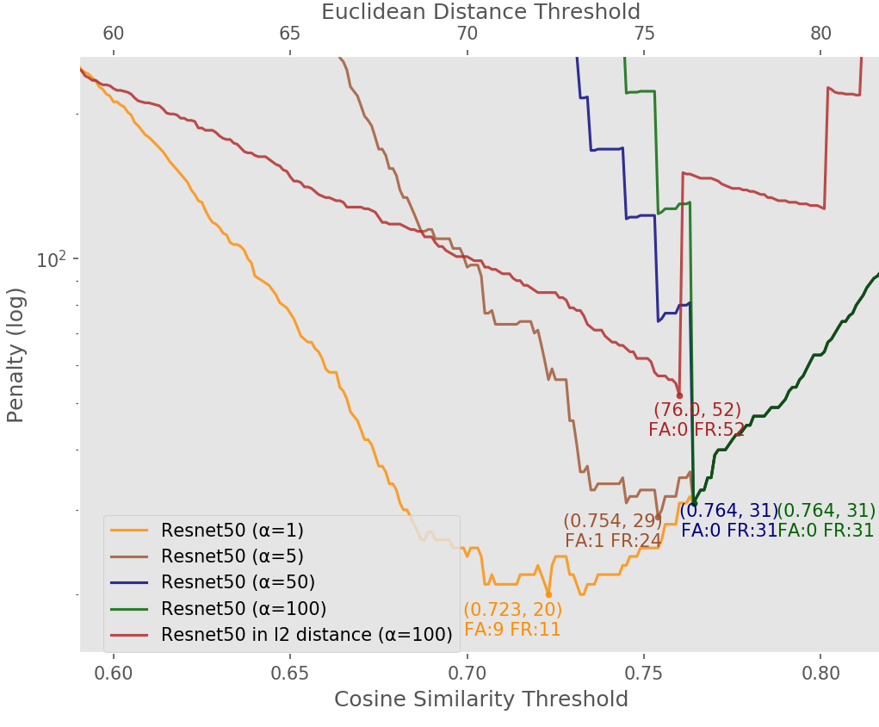
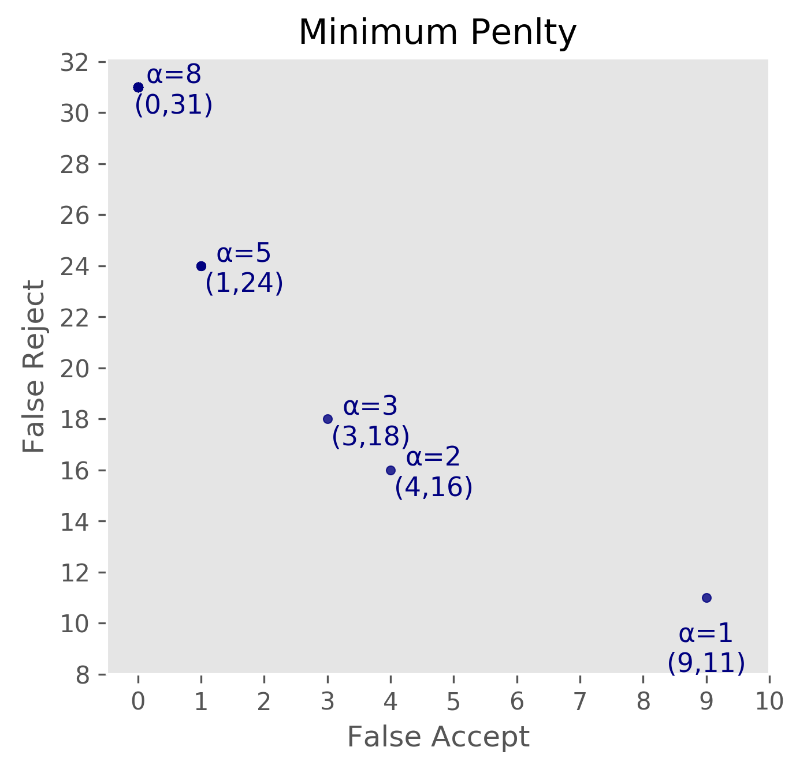
Experiments of Face Verification (cont.)
Face verification penalty curve
Notes:
換顏色 多一個圖fp/fn與alpha的關係

Slide 31
Experiments of Face Verification (cont.)
Compare the effect of Aggregation and Alignment
Notes:
有取mean的效果都比較好
然後橘色是沒做alignment
藍色是只有在test的時候做alignment
綠色是train/test都有alignment

Slide 32
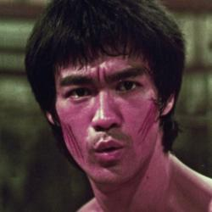
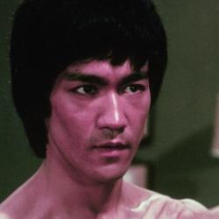
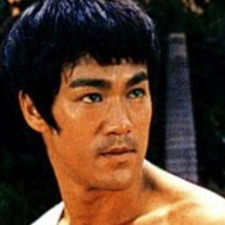
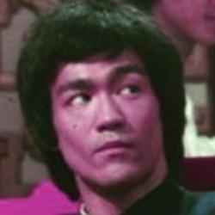
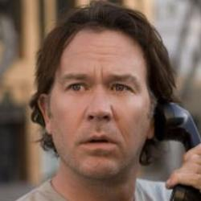

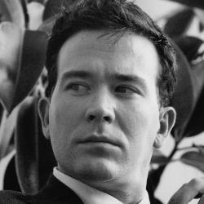
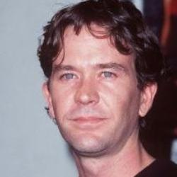
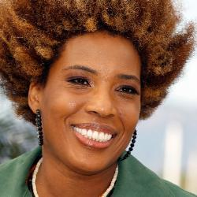
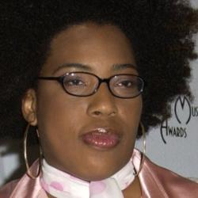
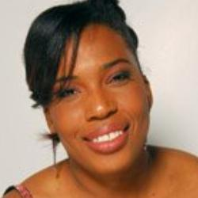
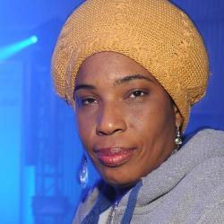
Experiments of Face Identification
CASIA-WebFace
10,575 identities, 494,414 face images
Select 10,559 identities whose images count is more than 5
Remove 27,703 wrong images after data cleaning

Slide 33
Experiments of Face Identification
Performance of face identification on CASIA-WebFace
No. | Alignment | Fusion | Re-ranking | HNSW Time (s) | Mean Acc.
1 | × | × | × | 745 | 0.8447 ± 0.0014
2 | × | × | ✓ | 1459 | 0.8490 ± 0.0011
3 | × | ✓ | × | 730 | 0.8648 ± 0.0039
4 | ⋅ | ✓ | ✓ | 1445 | 0.8675 ± 0.0023
5 | ✓ | × | × | 1342 | 0.8297 ± 0.0023
6 | ✓ | × | ✓ | 2573 | 0.8351 ± 0.0015
7 | ✓ | ✓ | × | 1288 | 0.8526 ± 0.0030
8 | ✓ | ✓ | ✓ | 2570 | 0.8614 ± 0.0018

Slide 34
Experiments of Face Identification
Performance of face identification on CASIA-WebFace
Component | Configuration
Alignment |  |  |  | ✓ | ✓ |  | ✓
Fusion |  |  | ✓ |  |  | ✓ | ✓
Re-rank* |  | ✓ |  |  | ✓ | ✓ | ✓
Mean Acc. (%) | 84.47 | 85.50 | 86.48 | 82.97 |  | 86.75 | 86.14

Slide 35
Experiments of Face Identification (1/2)
FG-NET
82 identities, 1,002 images, cross-age, 0 to 69 years old
Leave-one-out strategy
Notes:
每個人幾張到幾張

Slide 36
Experiments of Face Identification
Performance of face identification on FG-NET
No. | Align. | Fusion | Re-rank | Rank-1 Acc.(%)
1 | × | × | × | 86.62
2 | × | × | ✓ | 86.82
3 | × | ✓ | × | 83.43
4 | × | ✓ | ✓ | 83.63
5 | ✓ | × | × | 87.32
6 | ✓ | × | ✓ | 87.72
7 | ✓ | ✓ | × | 84.33
8 | ✓ | ✓ | ✓ | 84.53
Method | Rank-1 Acc. (%)
HFA | 69.0
MEFA | 76.2
CAN | 86.5
LF-CNNs | 88.1
Ours | 87.72
Notes:
紅線

Slide 37
Experiments of Face Identification
Performance of face identification on FG-NET
Component | Configuration
Alignment |  |  |  | ✓ | ✓ |  | ✓
Fusion |  |  | ✓ |  |  | ✓ | ✓
Re-rank* |  | ✓ |  |  | ✓ | ✓ | ✓
Rank-1 Acc. (%) | 86.62 | 87.22 | 83.43 | 87.32 | 87.92 | 83.63 | 84.53
Method | Rank-1 Acc. (%)
HFA | 69.0
MEFA | 76.2
CAN | 86.5
LF-CNNs | 88.1
Ours | 87.92
Notes:
紅線

Slide 38
Experiments of Face Identification (2/2)
CACD (Cross-Age Reference Coding for Age-Invariant Face Recognition and Retrieval)
contains more than 160,000 images of 2,000 celebrities with age ranging from 16 to 62
face retrieval with three different subsets, 2004-2006, 2007-2009, 2010-2012images taken in 2013 are used as query
Two measurements: mAP / Precision@1(Rank-1 accuracy)

Slide 39
Experiments of Face Identification (2/2)
CACD
Methods | Rank-1 accuracy (%)
 | 04-06 | 07-09 | 10-12
LBP (2013) | 78.0 | 80.3 | 85.5
CARC (2014) | 88.8 | 88.5 | 92.2
Ours | 82.6 | 85.1 | 86.4
Ours + Re-rank | 85.7 | 86.9 | 88.2
Notes:
Chen, Bor-Chun, Chu-Song Chen, and Winston H. Hsu. "Cross-age reference coding for age-invariant face recognition and retrieval." European Conference on Computer Vision. Springer, Cham, 2014.

Slide 40
Conclusions and Future Work
Notes:
s _{＋future work}

Slide 41
Thank you for your attention

Slide 42
Experiments
Super-Resolution
WDSR (Wide Activation for Efficient and Accurate Image Super-Resolution, CVPR Workshop 2018)

Slide 43
Experiments of Face Recognition (cont.)
Error images Resnet50 (w/ mean)
(#251_3)
(#003_4)
Closest (#139)
Similarity: 0.806780
Closest (#157)
Similarity: 0.695130
Second Closest (#251)
Similarity: 0.800584
Second Closest (#003)
Similarity: 0.693844
Notes:
True matches and false matches are in green and red boxes, respectively

Slide 44
Experiments of Face Recognition (cont.)
Error images Resnet50 (w/ mean, alignment)
(#244_3)
(#314_2)
Closest (#436)
Similarity: 0.799393
Closest (#020)
Similarity: 0.854172
Second Closest (GT)
Similarity: 0.792944
Second Closest (GT)
Similarity: 0.835937

Slide 45
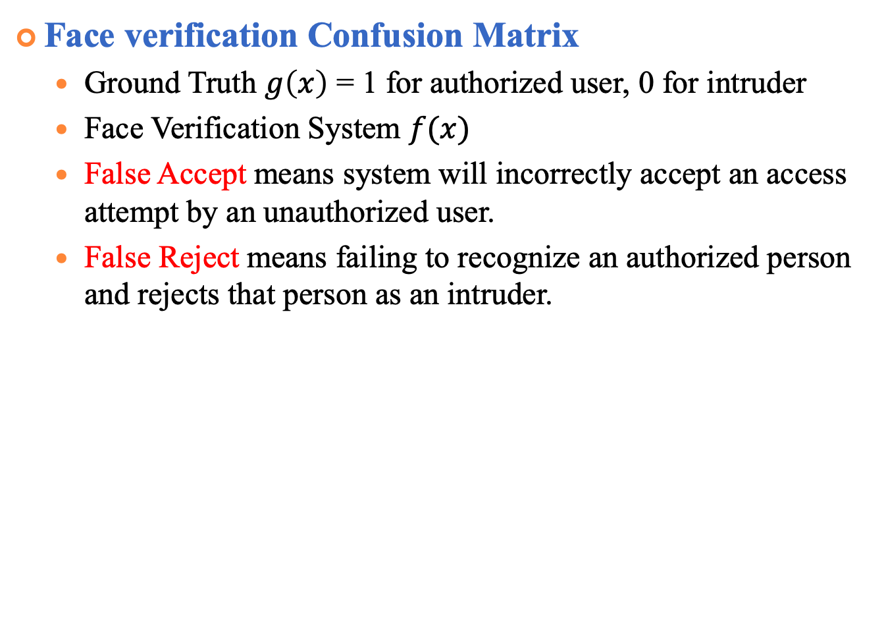
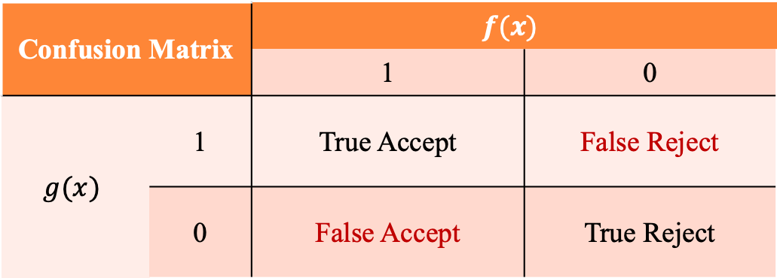
Experiments of face verification (cont.)
Face verification Confusion Matrix
Ground Truth $g\left(x\right)$ = 1 for authorized user, 0 for intruder
Face Verification System $f(x)$
False Accept means system will incorrectly accept an access attempt by an unauthorized user.
False Reject means failing to recognize an authorized person and rejects that person as an intruder.
Confusion Matrix |  | $$f(x)$$
 |  | 1 | 0
$$g(x)$$ | 1 | True Accept | False Reject
 | 0 | False Accept | True Reject
Notes:
http://www.mecs-press.org/ijigsp/ijigsp-v6-n2/IJIGSP-V6-N2-6.pdf 備用投影片

Slide 46
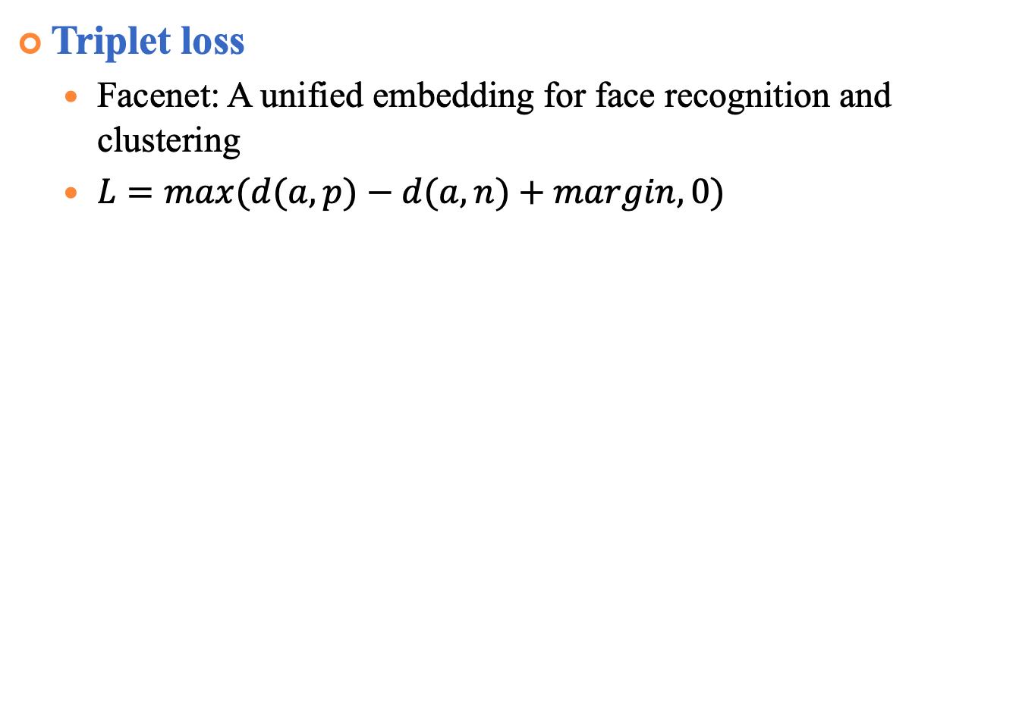
Triplet Loss
Triplet loss
Facenet: A unified embedding for face recognition and clustering
$L=max(d(a,p)−d(a,n)+margin,0)$
Notes:
有三個輸入一個是anchor positive negative

Slide 47
Experiments of Face Identification
Performance of face recognition on CASIA-FaceV5
No. | Alignment | Mean | Re-ranking | HNSW Time (s) | Ori. Time (s) | 100%-EER
1 | × | × | × | 27 | 55 | 98.8 (494/500)
2 | × | × | ✓ | 65 | 105 | 99.0 (495/500)
3 | × | ✓ | × | 22 | 32 | 99.6 (498/500)
4 | × | ✓ | ✓ | 48 | 73 | 99.6 (498/500)
5 | ✓ | × | × | 43 | 76 | 98.6 (493/500)
6 | ✓ | × | ✓ | 87 | 145 | 99.2 (496/500)
7 | ✓ | ✓ | × | 50 | 71 | 99.8 (499/500)
8 | ✓ | ✓ | ✓ | 92 | 151 | 99.8 (499/500)
Notes:
1 2比較是指有取mean表現比較好
2 3是指只有在test有alignment情況下反而不好
3 4是在train/ test都alignment情況下效果最好
4 5是在都有alignment情況下取mean的效果比較好
5 6代表rerank可以提升效果
同樣的 7 8也是rerank可以提升效果 加上取mean的照片

Slide 48
Experiments of Face Identification (cont.)
Error images of (w/ mean, both alignment)
Closest (#152)
Similarity: 0.698157
2nd Closest (#331)
Similarity: 0.673734
3rd Closest (#463)
Similarity: 0.669009
(#003_4)
4th Closest (#157)
Similarity: 0.667395
5th Closest GT)
Similarity: 0.659691
Notes:
Preprocessing ：subtract channel-wise mean mean channel values of all pictures in dataset.
[91.4953, 103.8827, 131.0912] (in BGR order).

Slide 49
Experiments of Face Identification (cont.)
Error images of (w/o mean)
(#118_2)
(#419_0)
(#115_3)
(#118_1)
(#320_4)
(#118_4)
(#262_ 0)
(#182_1)
(#295_2)
(#262_2)
(#244_1)
(#262_1)
(#188_3)
(#187_0)
(#188_2)
(#482_0)
(#084_2)
(#471_4)
Notes:
Preprocessing ：subtract channel-wise mean mean channel values of all pictures in dataset.
[91.4953, 103.8827, 131.0912] (in BGR order).

Slide 50
Experiments of Face Identification (cont.)
Error images (w/o mean, alignment)
(#118_2)
(#419_0)
(#115_3)
(#118_1)
(#118_4)
(#118_3)
(#143_2)
(#258_1)
(#143_4)
(#258_0)
(#436_1)
(#143_0)
(#188_3)
(#187_0)
(#188_2)
(#482_0)
(#188_4)
(#471_4)
Notes:
多加一個投票

Slide 51
Experiments of Face Identification (cont.)
Error images (w/o mean, test align, re-rank)
(#457_2)
(#312_3)
(#280_2)
(#409_0)
(#457_1)
(#409_2)
(#143_2)
(#258_1)
(#143_4)
(#258_0)
(#436_1)
(#143_0)
(#188_3)
(#187_0)
(#188_2)
(#482_0)
(#188_4)
(#471_4)
Notes:
多家simility 眼鏡可以加在future

Slide 52
Experiments of Face Identification (cont.)
Larger Dataset :
CelebA (Large-scale CelebFaces Attributes) Dataset
10,177 identities, 202,599 face images
Select 9343 identities whose images count is more than 5
http://mmlab.ie.cuhk.edu.hk/projects/CelebA.html

Slide 53
Experiments of Face Identification
Performance of face recognition on CelebA
No. | Database Align. | Test Align. | Mean | Re-ranking | Time (s) | 100%-EER
1 | No | No | No | No | 579 | 89.29 (8342/9343)
2 | No | No | Yes | No | 565 | 91.20 (8521/9343)
3 | No | Yes | Yes | No | 1110 | 90.51 (8456/9343)
4 | Yes | Yes | Yes | No | 1100 | 90.41 (8447/9343)
5 | Yes | Yes | No | No | 1110 | 88.44 (8263/9343)
6 | Yes | Yes | No | Yes | 2186 | 88.49 (8268/9343)
7 | No | Yes | No | No | 1122 | 88.59 (8277/9343)
8 | No | Yes | No | Yes | 2182 | 88.83 (8299/9343)
 | No | No | No | Yes | 1654
 | Yes | No | No | No

Slide 54
Experiments of Face Identification
Performance of face recognition on CelebA
No. | Alignment | Mean | Re-ranking | HNSW Time (s) | Ori. Time (s) | 100%-EER
1 | × | × | × | 579 |  | 89.29 (8342/9343)
 | × | - | ✓ | 1654
2 | × | ✓ | - | 565 |  | 91.20 (8521/9343)
4 | ✓ | ✓ | - | 1100 |  | 90.51 (8456/9343)
5 | ✓ | × | × | 1110 |  | 88.44 (8263/9343)
8 | ✓ | - | ✓ | 2182 |  | 88.83 (8299/9343)
Notes:
1 2比較是指有取mean表現比較好
2 3是指只有在test有alignment情況下反而不好
3 4是在train/ test都alignment情況下效果最好
4 5是在都有alignment情況下取mean的效果比較好
5 6代表rerank可以提升效果
同樣的 7 8也是rerank可以提升效果 加上取mean的照片

Slide 55
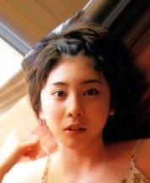













Experiments of Face Identification (cont.)
Error images of CelebA (w/ mean, no alignment)
(#10086)
(#5885)
Closest (#5061)
Similarity: 0.678934
Closest (#1178)
Similarity: 0.750887
Second Closest (#10086)
Similarity: 0.670884
Second Closest (#5885)
Similarity: 0.739673
Notes:
有些資料有重複
有去問作者了

Slide 56
Method of Re-ranking
Re-ranking policies
Ground truth: 118, predict: 419, re-ranking: 118
Ground truth: 312, predict: 409, re-ranking: 312
Ground truth: 187, predict: 187, re-ranking: 187
Ranking | 419_0 | 115_3 | 118_1 | 118_4 | 118_3
Similarity | 0.766 | 0.745 | 0.743 | 0.738 | 0.708
Ranking | 409_0 | 312_3 | 409_3 | 312_2 | 409_2
Similarity | 0.656 | 0.645 | 0.640 | 0.633 | 0.602
Re-ranking | 312 | 409
Avg. similarity | 0.639 | 0.633
Ranking | 187_0 | 188_2 | 482_0 | 188_4 | 471_0
Similarity | 0.763 | 0.689 | 0.677 | 0.658 | 0.651
Notes:
409_0, 312_3, 280_2, 012_3, 409_2

Slide 57
Experiments of Face Identification
Clean CASIA- WebFace
0130623裡面多個identities，刪除
0277213_359與0139549_020相同，刪除0277213_359
1569479_007與1569479_014相同，刪除1569479_014
0864308_148 與093刪除
1920049_007與015相同刪除015
3090922與3090925相同刪除3090925
5553911與5554445相同刪除5554445
0776090與0302108相同刪除0302108
0802108多個id 刪除
0819851刪除
刪除4129745_054
刪除2008435
2218397_007在test中是錯的同時2218397_006也是錯的同時刪除，換新的test
2501633_062在test中是錯的2501633_061也是錯的都刪除，換新的
3078995_007與3078995_017是一樣的，刪除017與007，換一個test
3083350與3083571一樣，刪除3083350
刪除1544100
1069180_007在test中是錯的同時1069180_014也是錯換一個新的test
1175262_010是錯的刪除
刪除2286416_007換一個新的test
刪除3285193_020換一個新的test, 3285193_009,014刪除
刪除3432505_020換一個新的test, 3432505_023刪除
刪除4525233_020換一個新的test,4525233_012刪除
刪除0785842_020換一個新的test0785842_012刪除
2130844_007在test中是錯的，同時2130844_012也是錯的，都刪除換一個新的test
5725655與5743918相同刪除5725655
Notes:
1 2比較是指有取mean表現比較好
2 3是指只有在test有alignment情況下反而不好
3 4是在train/ test都alignment情況下效果最好
4 5是在都有alignment情況下取mean的效果比較好
5 6代表rerank可以提升效果
同樣的 7 8也是rerank可以提升效果 加上取mean的照片

Slide 58
Method
Face verification
Face
identification
Measure similarity
Face
Detection
Face
Alignment
Face Feature Extractor
Re-ranking
Input image
Aligned face
Face representations
Below the
threshold
Barack Obama
Intruder
Notes:
合成一張

